Slide 1
COLOURIZING BLACK AND WHITE IMAGES USING GAN’S
Created by
K.B.Nagalakshmi
Reg.no.912321104027
III Year CSE
SACS MAVMM engineering college, madurai

Slide 2
Project Agenda:
Problem statement
Proposed System/Solution
System Deployment Approach
Algorithm and Deployment
Result
Conclusion
Reference

Slide 3
Problem Statement:
There have been many efforts to colorize an image. However, colorful image colorization by automatic colorization is one of the most successful approaches.we will use generative adversarial network (GAN) and open CV library in python for coding this task

Slide 4
Proposed system/solution:
1.Data collection and preprocessing:
Gather a large dataset of paired black and white images along with corresponding color image.
preprocess the image by resizing them to a standard resolution, normalizing pixel values and augmenting the dataset if necessary to increase its diversity.
2.Model Architecture:
Design the architecture for the GAN.
Use a conditional GAN framework where both the generator and discriminator receive the back and white image as input.

Slide 5
Proposed system/solution (Contd...)
3.Training:
Split the dataset into training and validation sets.
Train the GAN on the training set, optimizing the generator and discriminator networks simultaneously.
Monitor the validation set performance to avoid over fitting and ensure generations.
4.Evaluation:
Evaluation the trained model on the validation set using metrics such as perceptual similarity, color accuracy and visual inspection
5.Deployment:
Once satisfied with the model’s performance, deploy it for colorizing new black and white images.
provide options for users to adjust parameters such as color saturation or style transfer to customize the colorization process

Slide 6
Proposed system/solution (Contd...)
6.Monitoring and Maintenance:
Continuously monitor the model’s performances and gather user feedback to identify areas for improvement.
Periodically retain the model with updated datasets or fine-tune it based on new requirements or advancements in GAN techniques.
7.Ethical considerations:
Ensure that the system respects copyrights laws and privacy concerns when handling user-uploaded images.
Clearly communicate to users how their data will be used and stored
Implement safeguards to prevent misuse of the system, such as filtering inappropriate content

Slide 7
System Deployment Approach:
1.Problem Definition:
Clearly define the problem statement and objectives of the project.
Determine the target audience and use cases for the colorization system.
2.Data Collection and Preparation:
Gather a large dataset of paired black and white images and their corresponding color images.
Ensure that the dataset covers diverse scenes and subjects to improve the models generalization ability.
3.Model Selection and Design:
Choose a suitable GAN architecture for image-to-image transaction tasks, such as pix to pix and SPADE.

Slide 8
System Deployment Approach (Contd...)
Design the generator and discriminator networks, considering factors like model complexity ,convergence speed and output quality.
4.Training:
Split the dataset into training and validation sets.
Train the GAN on the training data using techniques like adversarial training, cycle consistency loss and perceptual loss.
5.Evaluation:
Evaluation the trained model on the validation set using metrics such as perceptual similarity, color accuracy and visual inspection.
Fine-tune the model based on evaluation results and iterate on the training process if necessary.
6.Deployment and Integration:
Integrate the trained model into a deployment pipeline or application.

Slide 9
System deployment Approach (Contd...)
Develop a user interface for uploading black and white images and displaying the colorized results.
7.Testing and Validation:
Conduct extensive testing of the deployed system to ensure functionality, reliability and performance
Validate the colorization results against ground truth color image and user expectations.
8.Documentation and maintenance:
Provide comprehensive document for uses and developers , including instructions for using the system and API documentation.
Establish a maintenance pan for the system, including regular updates, bug fixer and support channels for user inquiries

Slide 10
Algorithm and Deployment :
1.Data Collection and Preprocessing:
Gather a dataset of paired black and white images along with corresponding color version.
preprocess the image by resizing them to a consistent resolution and possibly normalizing pixel values.
2.Model Architecture Selection:
Choose a suitable GAN architecture for a task , such as a conditional GAN or pix to pix model, which are commonly used for image-to-image transaction tasks like colorization
3.Evaluation:
Evaluation the trained model on the validation set using metrics such as perceptual similarity, color accuracy and visual inspection

Slide 11
Algorithm and Deployment (Contd...)
4.Deployment:
Deploy the trained model for colorizing black and white images.
This could involves integration it into an application or making it available as a standard tool.
5.Post-processing:
Apply any necessary post-processing techniques to refine the colorized images such as smoothing

Slide 12
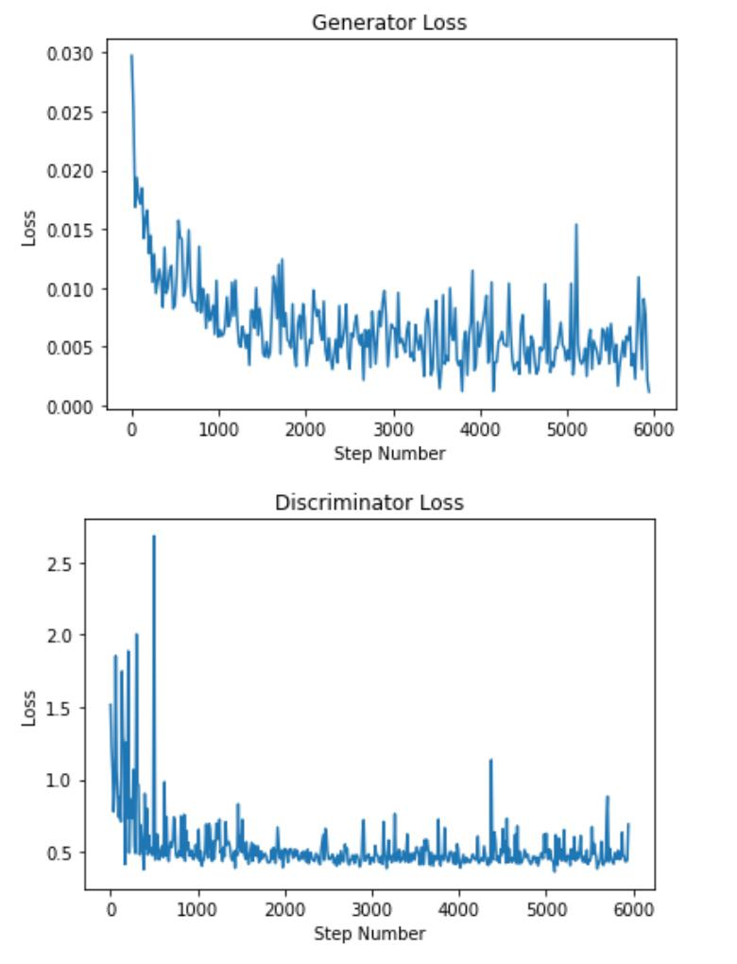
Result:
Fig : Colorizing Grayscale Simpson Faces Using a GAN

Slide 13
Conclusion:
the GANs have proven be a powerful tools for colorizing black and white images.This technology has applications in various fields,Including historical image restoration, artistic rendering and digital entertainment Despite their success, ongoing research aims of further improve the fidelity and efficiency of GAN-based colorization techniques

Slide 14
Reference:
https://www.slideshare.net/YashSaraf1/image-colorization
https://towardsdatascience.com/colorizing-black-white-images-with-u-net-and-conditional-gan-a-tutorial-81b2df111cd8
Dataset:
https://www.kaggle.com/datasets/aayush9753/image-colorization-dataset

Slide 15
Thank you

